Slide 1
CEIS106 Final Course Project

Slide 2
Introduction
In this project we used Ubuntu which is a Linux distribution based on Debian and composed mostly of free open source software.
Within Ubuntu we learned everything from navigating the filesystem tree, to adding users in CLI, to using network utilities.

Slide 3
First step
In the first steps we learned the basics navigating through the filesystem tree.
Created and located directories and files.
And finally we learned how to copy and remove directories and files.

Slide 4
Navigate the Linux filesystem tree
1. What is the pwd command an acronym for? What about the cd command?
Answer here:
pwd: current working directory
cd: change directory
2. Explain the differences between a relative path and an absolute/full path in Linux.
Answer here:
An absolute path is defined as specifying the location of a file or directory from the root directory(/). In other words,we can say that an absolute path is a complete path from start of actual file system from / directory. Relative path is defined as the path related to the present working directly(pwd).
References:
1. https://www.geeksforgeeks.org/absolute-relative-pathnames-unix/#:~:text=An%20absolute%20path%20is%20defined%20as%20specifying%20the%20location%20of,actual%20file%20system%20from%20%2F%20directory.&text=Relative%20path%20is%20defined%20as,present%20working%20directly(pwd).

Slide 5
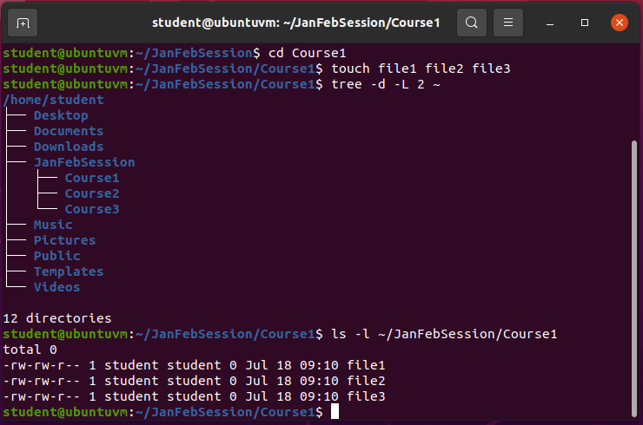
Create directories and files

Slide 6
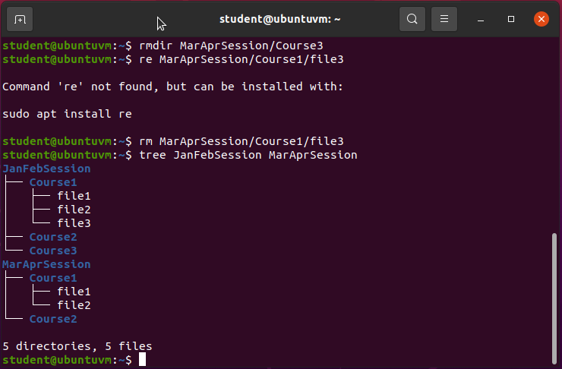
Copy and remove directories and files

Slide 7
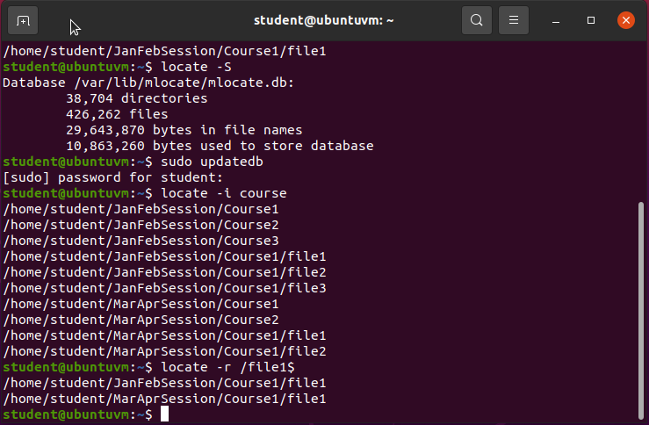
Locate directories and files

Slide 8
Second Step
Created shell scripts
Change script file permissions
Set PATH variable
Make the path variable permanent

Slide 9
Create a shell script
1. What are the file permissions of the script?
Answer here:
rw- for the owner-- and write only (no execute)
rw- for the group – read and write only (no execute)
r-- for everyone else – read only (no write or execute)
2. What’s the name of the user-defined variable in the script?
Answer here:
text
3. Which redirection meta-character is used in the script? What does it do?
Answer here:
>> -- redirects the output to the file and appends to the file (single arrow, > -- will overwrite file)
References:
1.Project recording
2.Live Session

Slide 10
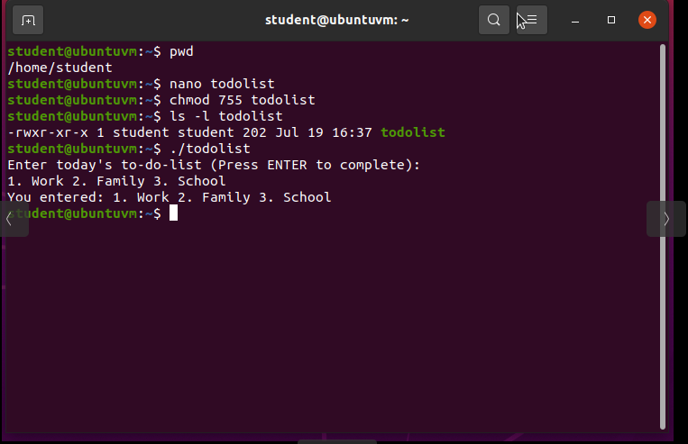
Change script file permissions

Slide 11
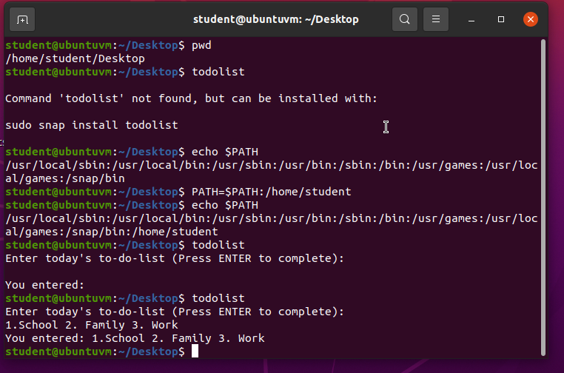
Set the PATH variable

Slide 12
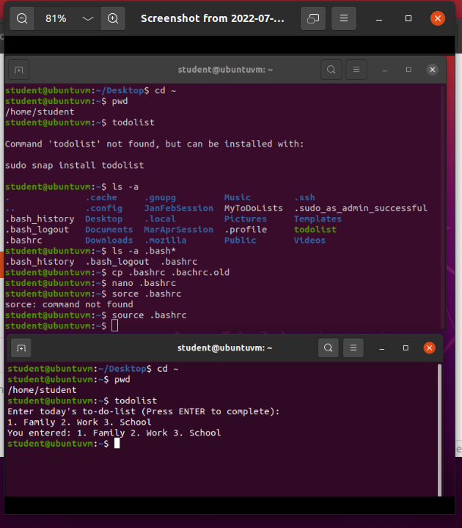
Make the PATH variable permanent

Slide 13
Third Step
Added users and groups in CLI
Tested user a group settings
Add users in GUI
Removed users and groups

Slide 14
Add users and groups in CLI
1. What does the –m option in the useradd command do?
Answer here: will create a home directory for the user.
2. What does the -3 option in the tail command do?
Answer here: show the last three lines.
3. Which line of the /etc/group file lists members of the “students” group? Copy it here.
Answer here:
References:
1.Project video
2.Project guide

Slide 15
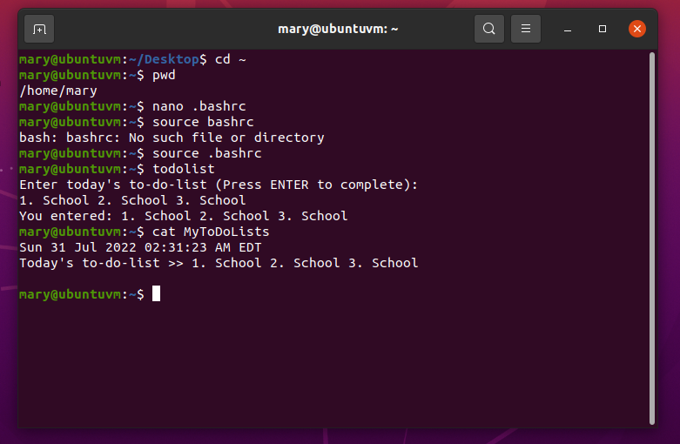
Test user and group settings

Slide 16
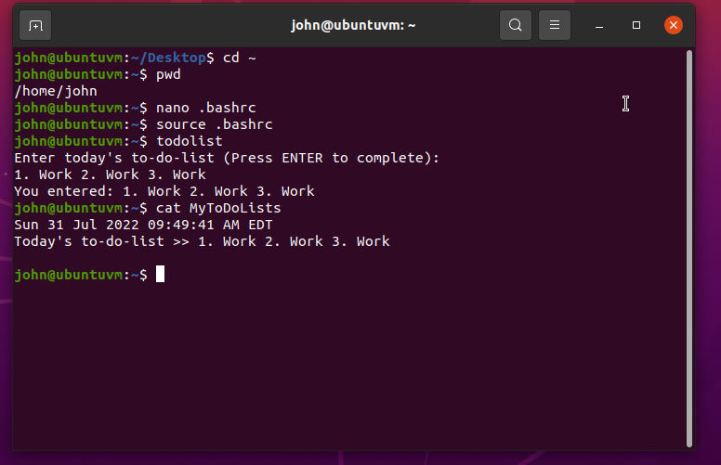
Add users in GUI

Slide 17
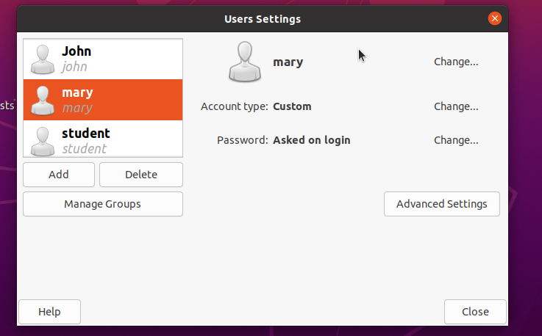
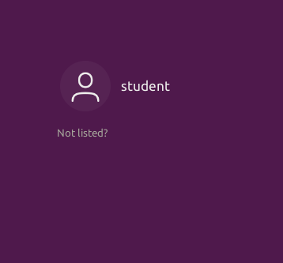
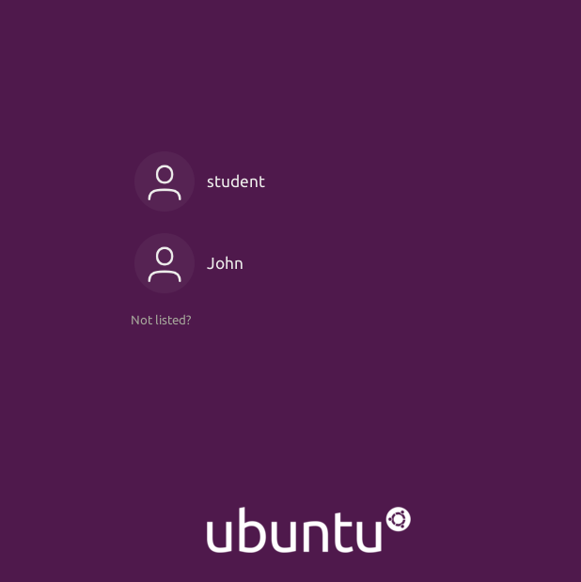
Remove users and groups

Slide 18
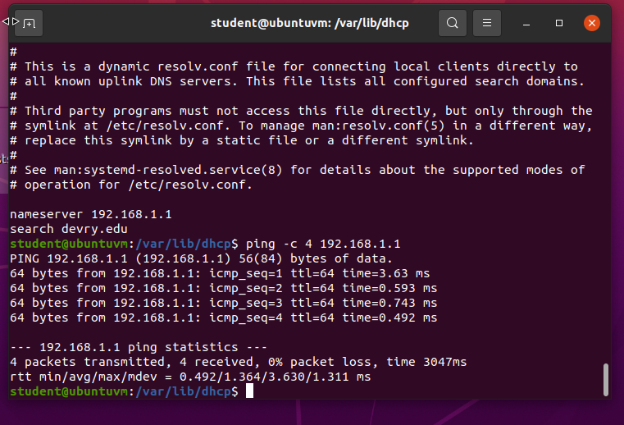
Discover host IP configurations
1. What is the IP address of your Ubuntu machine?
Answer here:192.168.1.104
2. What is the IP address of its default gateway?
Answer here:192.1681.1
3. What is the IP address of its DHCP server?
Answer here:192.168.1.1
4. What is the IP address of its DNS server?
Answer here:192.168.1.1

Slide 19
Manage network interfaces
1. Which DHCP message is shown in the output of the sudo dhclient –v –r eth0 command? [hint: the message name is in uppercase.]
Answer here:DHCPRELEASE
2. Which four DHCP messages are shown in the output of the sudo dhclient –v eth0 command? [hint: the message names are in uppercase.]
Answer here:
DHCPDISCOVER, DHCPOFFER, DHCPREQUEST,DHCPACK
References:
1.Completing the course project
2.

Slide 20
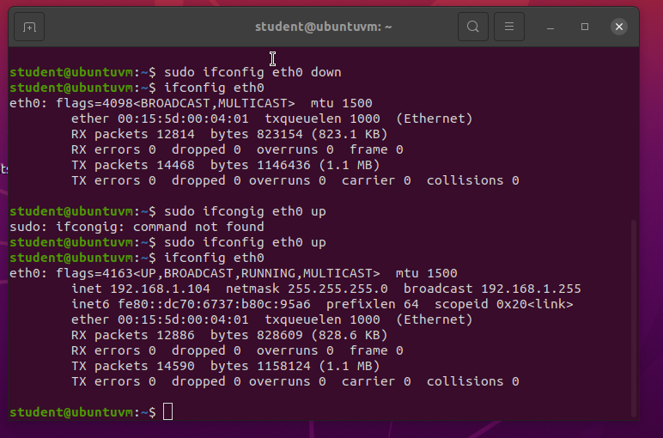
Use network utilities

Slide 21
Monitor Linux processes
1. What is the default action of the 15 SIGTERM kill signal?
Answer here:
Kill the highlighted process
2. In the System Monitor window, click on % CPU to sort the processes by CPU load. Which process shows the highest percentage of CPU usage?
Answer here:
gnome-shell
References:
1.Completing the project
2.

Slide 22
Monitor user activities
Issue the sudo accton on command to turn on GNC accounting. Run the sudo updatedb command. Enter lastcomm updatedb to check if the updatedb command was executed before. Remember to turn off GNC accounting (sudo accton off) after answering the questions.
1. What flag value is displayed in the output?
Answer here: means the command was executed by the root (superuser)
2. Why is the name of the user who ran the processes shown as root, not student?
Answer here: We put “sudo” in front of the command, which means “superuser do” and caused the root user (superuser) to execute the command for us
References:
1.Project help video
2.

Slide 23
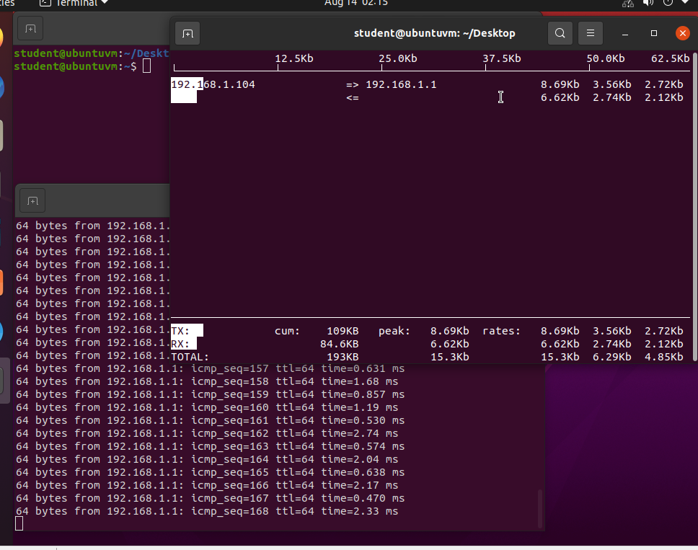
Monitor network bandwidth usage

Slide 24

Communication Skills
Learned about professional topics and language through daily discussions.
Watching the live sessions was very helpful to understanding certain things not only from the professors but from the other students.

Slide 25
Career Skills
Several career skills were gained in this project like
Scripting
Network, monitoring, and management
Linux experience

Slide 26
Conclusion
This project covered the fundamental topics of Linux, by learning the basics of Ubuntu we were able to navigate though the filesystem tree, add and remove users, monitor and manage networks
Building this project provided a hands on learning opportunity to put into practice the topics covered in the course.

